Slide 1

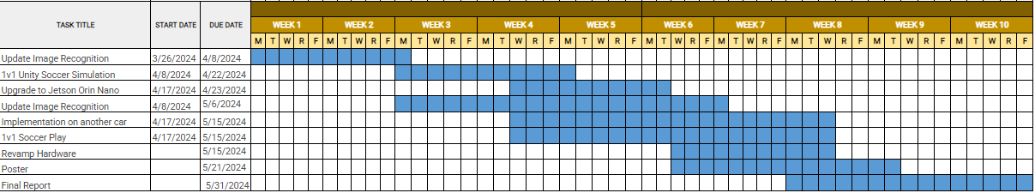
Overview
JetRacer Soccer Jarod Marshel, Casey Rittenhouse, Arjun Simha, Mason Kang, K Gupta, Julie Ham, Cooper Ritter
Overall Concept:
Overall Project Deliverable | Progress
Basic Movement | Done
Image recognition | Done
New sensor implementation | In progress
Object following/Ball Striking | In progress
Co-op and Versus | Not started
Github with documentation | In progress
Summary and report | In progress
New Sensor
Project is On Schedule
Gantt Chart/Schedule

Slide 2
Short-Term
JetRacer Soccer Jarod Marshel, Casey Rittenhouse, Arjun Simha, Mason Kang, K Gupta, Julie Ham, Cooper Ritter
Previous Meeting Action Items:
Item | Description | Owner | Target Date | Status
1 | Build field for cars | Jarod | Feb 19 | Done
2 | Unity soccer simulation training | Mason | Jan 31 | Done
3 | Object following | Everyone | Mar 8 | Done
4 | Implement new sensor onto car | Everyone | Mar 11 | Done
5 | Preliminary Design Review | Everyone | Mar 12 | Done
6 | Retrain Object Detection | CV team | April 15 | In Progress
7 | 1v1 Soccer | Everyone | May 1 | Not started
Biweekly Action Items:
Item | Description | Owner | Target Date | Status
1 | Retrain Object Detection | CV team | April 15 | In Progress
2 | 1v1 Soccer Logic | Not assigned | May 1 | Not started
3 | Set up software on cars | Casey | April 20 | In Progress
4
5
Significant Roadblocks/ Non-developing Items:
Budget:
Jetson Orin ZED SDK version conflict
Total Proposed | Plan to Date | Used to Date | Used Vs Plan
$3500 USD | $1450 USD | $650 USD | +$1400 USD
Short Term Schedule:
Request for teaching staff:
Apr |  |  |  |  |  |  |  |  |  | Feb
11 |  |  |  |  | 16 |  |  |  |  | 21
Train new YOLOv8
Start upgrade to Orin

Slide 3
Team Progress

Slide 4
ROS (Casey and Cooper and Arjun)
JetRacer Soccer Jarod Marshel, Casey Rittenhouse, Arjun Simha, Mason Kang, K Gupta, Julie Ham, Cooper Ritter
Previous Work:
Determined Jetson Orin is necessary to complete desired function
Planned versions for all necessary packages to ensure compatibility
Looked into Docker and JetPack
Future Work:
Purchase Jetson Orin
Migrate current work to the Orin
Continue to improve ROS structure
Install Zed SDK
Configure Docker and JetPack

Slide 5
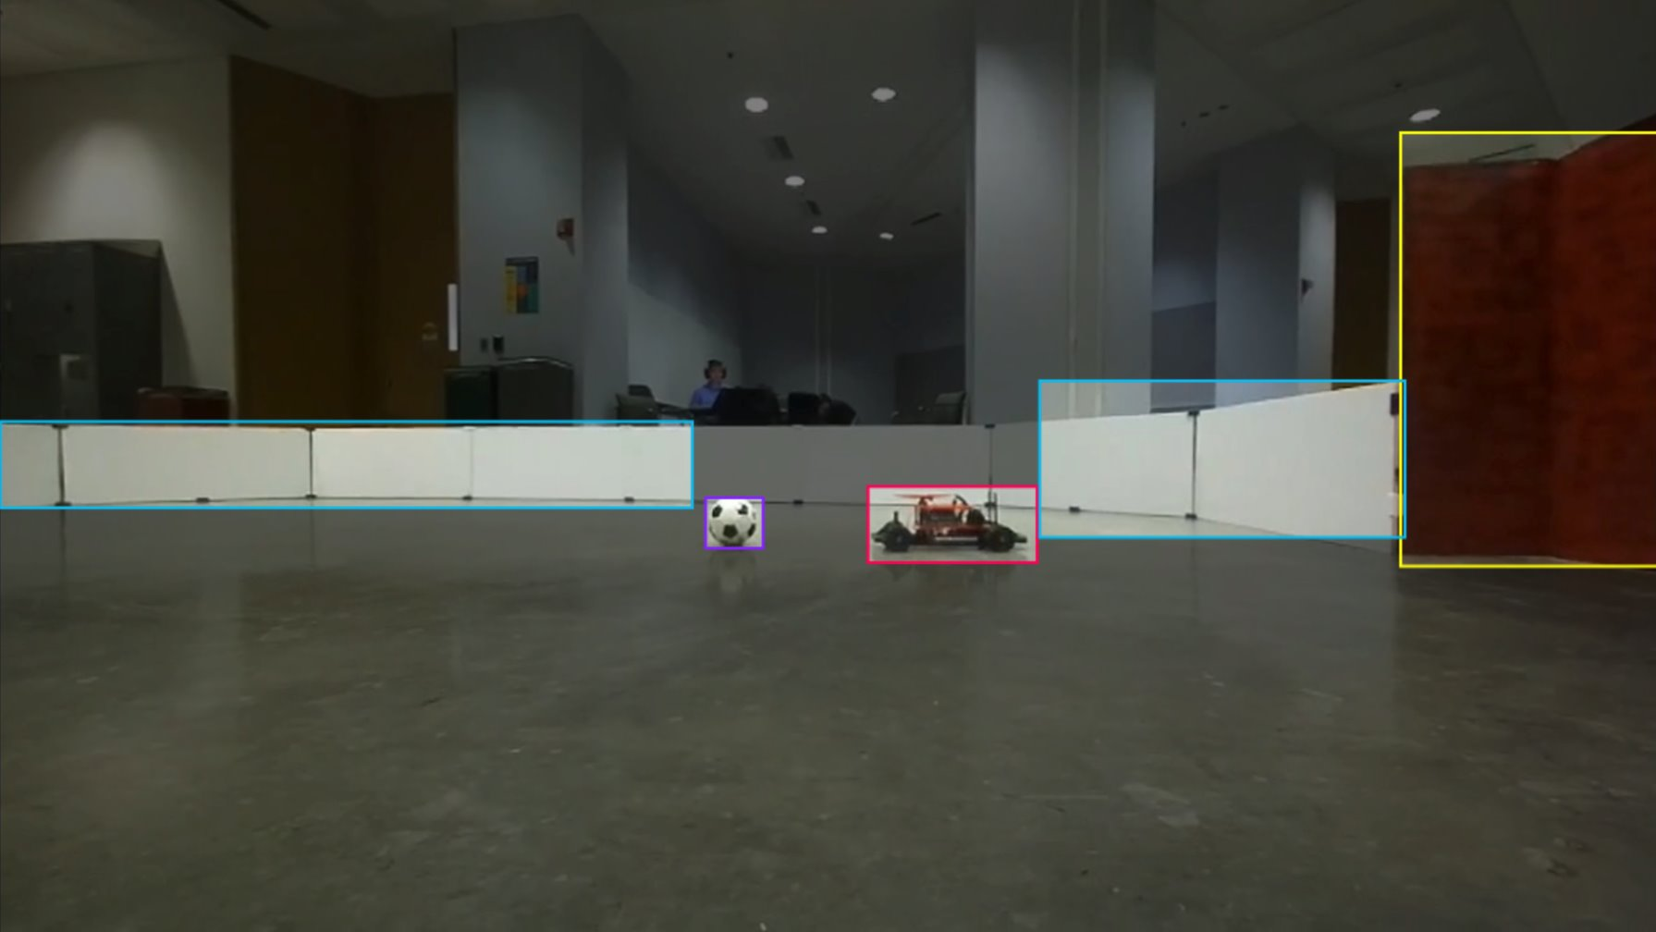
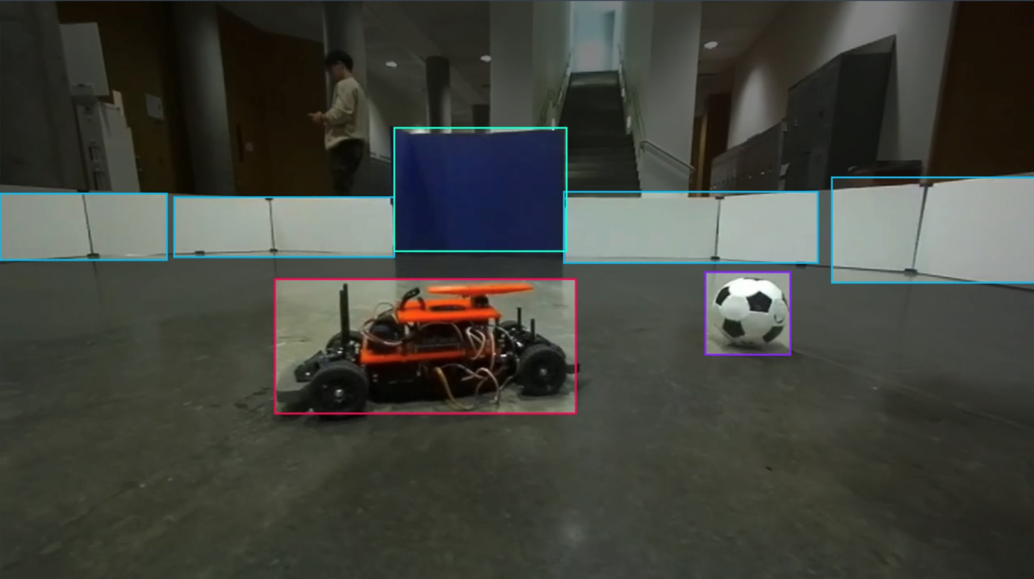
Computer Vision (K and Julie and Jarod)
JetRacer Soccer Jarod Marshel, Casey Rittenhouse, Arjun Simha, Mason Kang, K Gupta, Julie Ham, Cooper Ritter
Previous Work:
Annotated new dataset
Started training weights for YOLOv8
Future Work:
Run a YOLOv8 detection program
Work with ROS team to set up publisher and subscriber for steering servo and ball following

Slide 6
Unity (Mason)
JetRacer Soccer Jarod Marshel, Casey Rittenhouse, Arjun Simha, Mason Kang, K Gupta, Julie Ham, Cooper Ritter
Previous Work:
Create a 3rd year repo for the JetRacer project.
Optimize the Unity simulation as much as possible.
Future Work:
Further document the GitHub page.
Gather details about the Unity training and use them to prepare for the winter presentation.

Slide 7
Team Roles
Project Manager - Jarod
Point of Contact - Arjun
Budget Manager - Casey
ROS/Hardware (Layout, PCB, CAD, LiDAR):
Cooper, Casey, Jarod, Arjun
Unity Team:
Mason
CV/Image Recognition Team:
K, Julie

Slide 8
Previous Year's Work
Built and gained full range of motion of 4 JetRacers using software
Set up a simulation environment to virtually train the agents
Structured a reward system for the reinforcement learning model
Implemented object detection model that identifies a soccer ball, opponent, and goal
Implemented software to follow and strike a ball
Developed logic process for striking a ball into a goal
Simulation results with reward structure demonstrate that agents can be trained to efficiently compete in a 2v2 soccer match
Created a GitHub page documenting the hardware and software instructions to setup JetRacers, a summary of the work completed, and plans for future work

Slide 9
Our Final Deliverables
Demonstrate basic motion of JetRacer: 01/2024
Demonstrate JetRacer Image Recognition for soccer play: 01/2024
Trade study of possible sensor additions: 02/2024
Preliminary Design Review: 02/2024
Showcase vehicle scoring soccer ball in the goal in real-world: 03/2024
Add additional agents in the real world: 04/2024
Final Data Review: 05/2024

